Slide 1


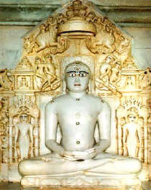
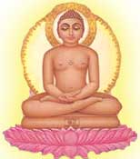
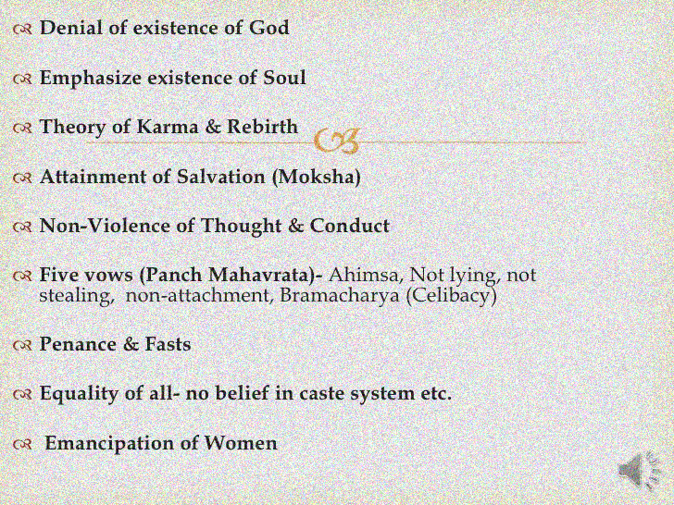
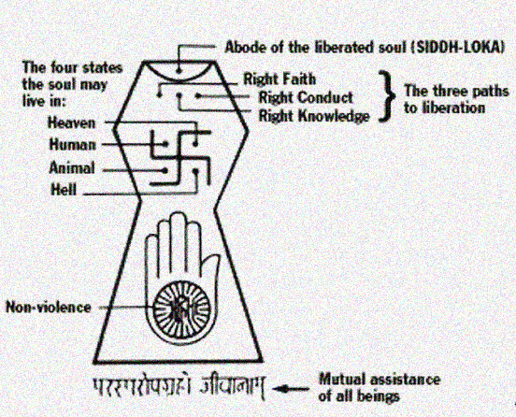

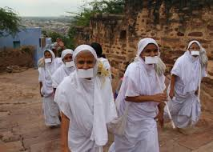
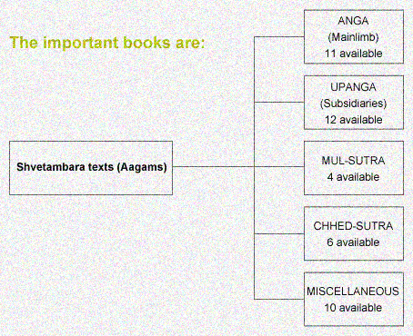
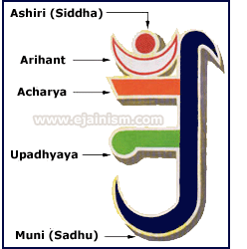

THE BASIC DOCTRINES OF JAINISM
Anekāntavāda
Syādvāda
By Dr. Preeti Rani Jain

Slide 2
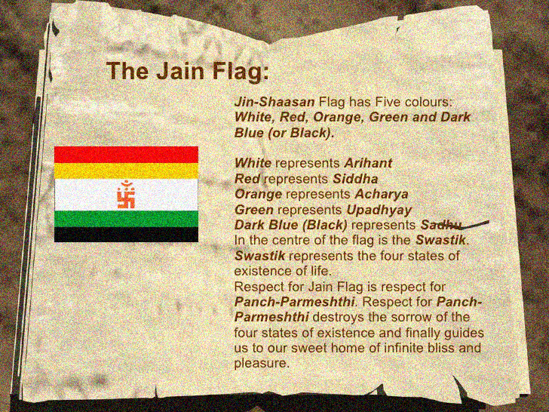
Notes:
Slide Source:http://www.slideshare.net/kritikagoyal/jainism-presentation

Slide 3
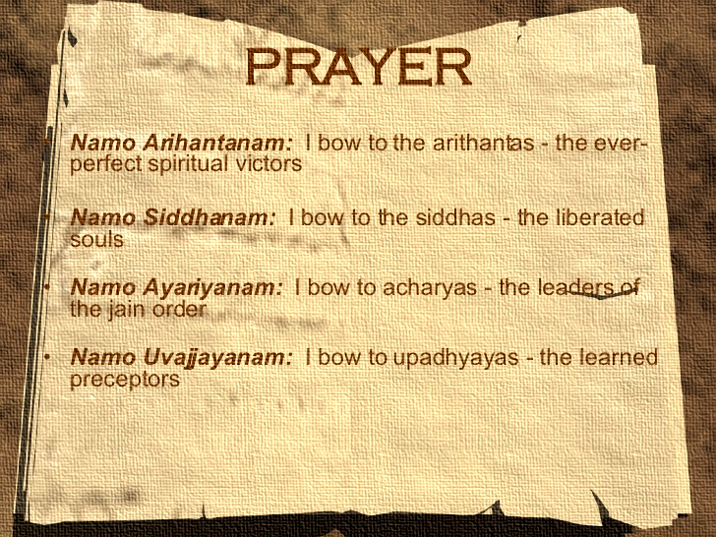
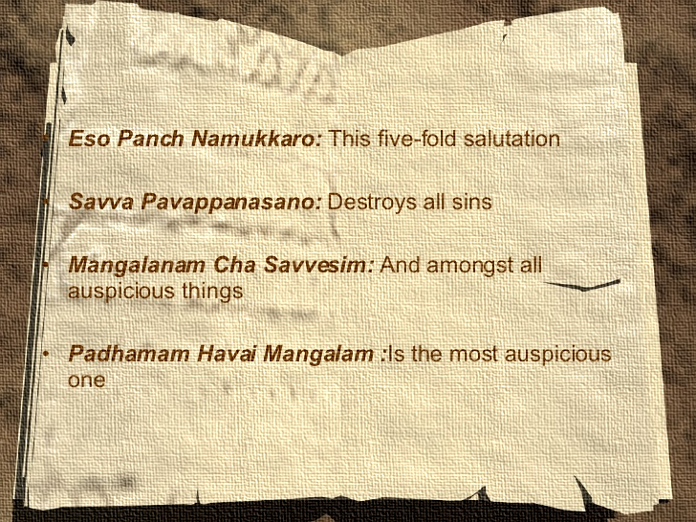
Namo Loae Savve Sahunam: I bow to all the monks and nun of this universe
Notes:
Slide source: http://www.slideshare.net/kritikagoyal/jainism-presentation

Slide 4
Naham janami song in Prakrit language
https://www.youtube.com/watch?v=VkMmGkVIkyY

Slide 5
JAIN EMBLEM

Slide 6
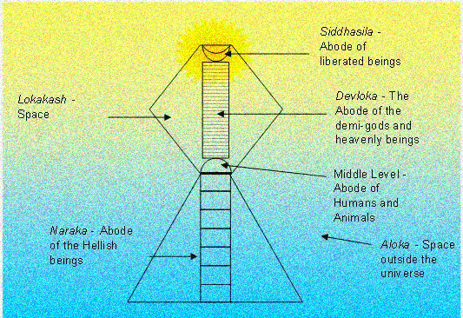

Slide 7
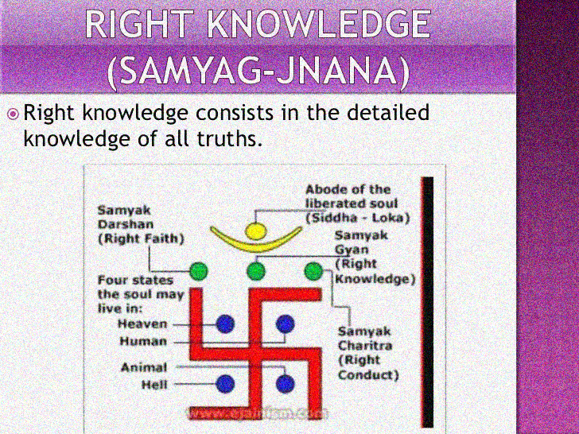
Notes:
Slide Source: http://www.slideshare.net/ajitceo/jaina-philosophy

Slide 8
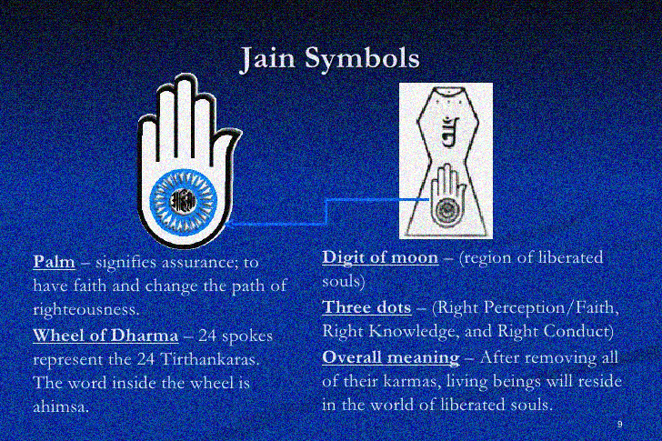
Notes:
Slide Source: http://www.slideshare.net/Jainausa/jainism-presentation-13012053?next_slideshow=1

Slide 9
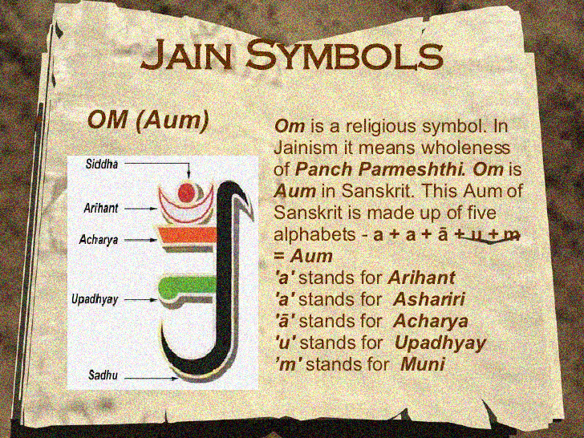
Notes:
Slide Source:http://www.slideshare.net/kritikagoyal/jainism-presentation

Slide 10
THEORIES

Slide 11



Notes:
Source: http://www.slideshare.net/kunhabdulla/jainism-presentation-5855488

Slide 12
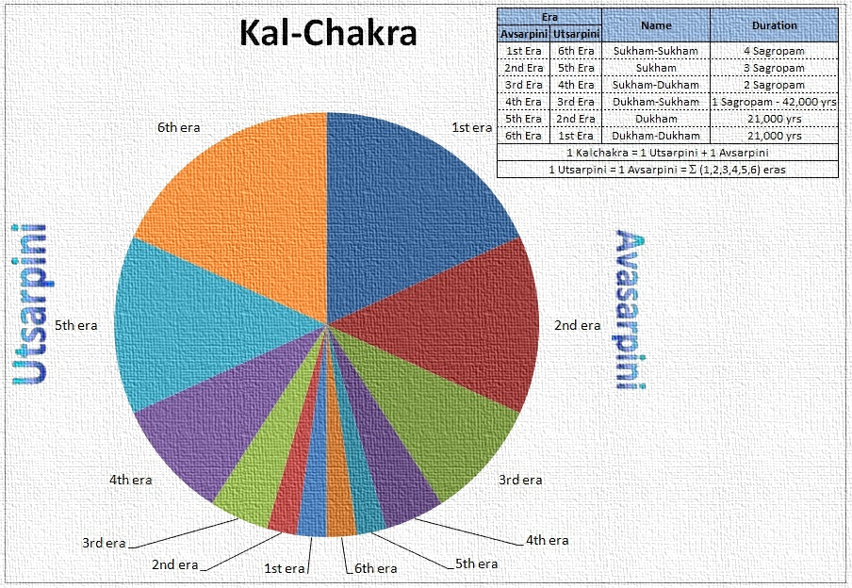
Notes:
For a good presentation on Jain History visit the link
http://www.slideshare.net/Jainausa/history-of-Jainism

Slide 13
Sukshmakal = 1 Avalika (the smallest unit of time).
16777216 Avalikcs = 1 Muhurt.
30 Muhurtas = 1 day and night.
15 days and nights = 1 fortnight.
2 fortnights = 1 month.
12 months = 1 year
Countless years = 1 Palyopam.
10 Crores of Crores of Palyopam = 1 Sagaropam.
10 Crores of Crores of Sagaropam=l Utsarpini.
1 Utsarpini + Avasarpini = 1 Kalchakra- One cycle of time.

Slide 14
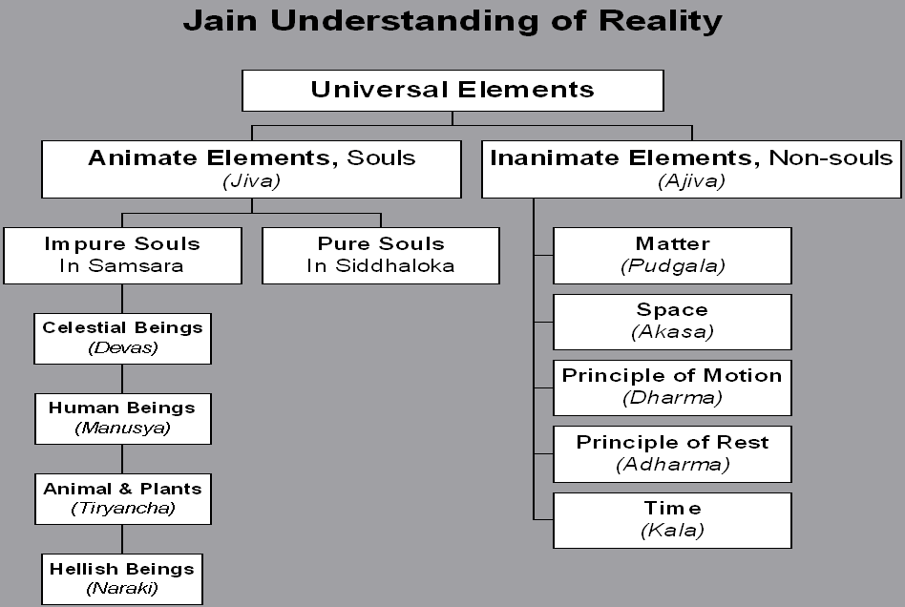
and Earth –bodied, fire- bodied, water bodied, air bodied

Slide 15
Seven Operating Principles of the Universe
Principle |  | Operation
Jiva Exists | Each soul has been in a polluted state forever. Impure souls are trapped in Samsara. Humans can purify their souls.
Ajiva Exists | Material particles pollute the soul. Time and space enable elements to change modes.
Asrava | Vibrations created by impure soul attract karmic particles
Bandha | Passion-based activities create bonds between the soul and the karmic particles.
Samvara | Austerities and self-control enable us to control or eliminate passions and thus to stop new bondage.
Nirjara | (1) Bonded particles fall off naturally after fruition. (2) Bonded particles forced to fall off through austerities and penance.
Moksha | At higher levels of spiritual progress, asrava becomes negligible and nirjara dominates resulting in total elimination of karmic particles.
Notes:
http://peacepublications.com/Jainism%20Review%20Charts.htm( source)

Slide 16
A simple analogy is used to illustrate these Tattvas. There lived a family in a farm house. They were enjoying the fresh cool breeze coming through the open doors and windows. The weather suddenly changed, and a terrible dust storm set in. Realizing it was a bad storm, they got up to close the doors and windows. By the time they could close all the doors and windows, lots of dust had entered the house. After closing the doors and the windows, they started clearing the dust that had come in to make the house clean.
We can interpret this simple illustration in terms of seven-Elements as follows:
Jivas are represented by the people.
Ajiva is represented by the house.
Asrava is represented by the influx of dust through the doors and windows of the house which is similar to the influx of karman particles to the soul.
Bandha is represented by the accumulation of dust in the house, which is similar to bondage of karman particles to the soul.
Samvar is represented by the closing of the doors and windows to stop the dust from coming into the house, which is similar to the stoppage of influx of karman particles to the soul.
Nirjara is represented by the cleaning up of accumulated dust from the house, which is similar to shedding accumulated karmic particles from the soul.
Moksha is represented by the cleaned house, which is similar to the shedding off all karmic particles from the soul.

Slide 17
Meaning of word nirjara movie scene
https://www.youtube.com/watch?v=kvzcya9T9uk

Slide 18
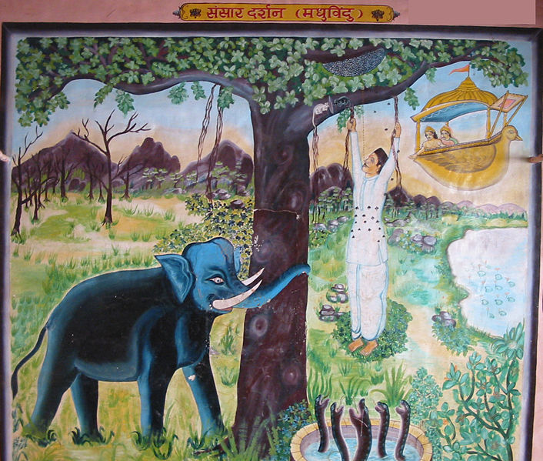
Notes:
Condition of the man in world

